Slide 1
Finding the Best Pizza in Town
Kevin Miller

Slide 2
Business Problem
Everyone seems to be looking for the ‘best pizza in town’
In general, consumers want the very best of whatever type of food they desire
Information can be used for marketing purposes of a particular restaurant, or for recommendation apps or search engines
Objective decision based on the subjective input of consumers
I tried to find the answer to this question for Rochester, MN where I live

Slide 3
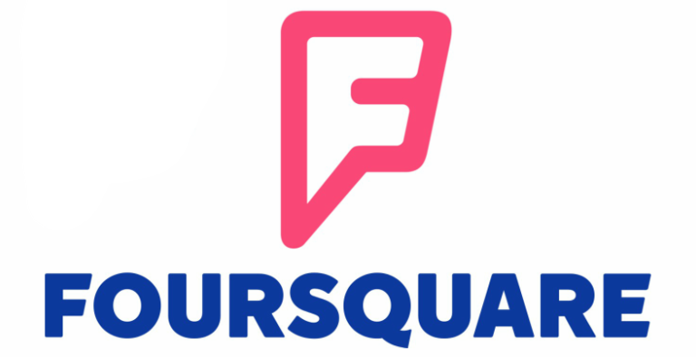
Data
Geospatial data from the Foursquare API
Limited available calls per day limited data available for use
Used the following data specifically for decision making:
Latitude and Longitude data for Rochester, MN and venues
Venue Name
Venue Category
Venue Rating
Venue Number of Likes

Slide 4
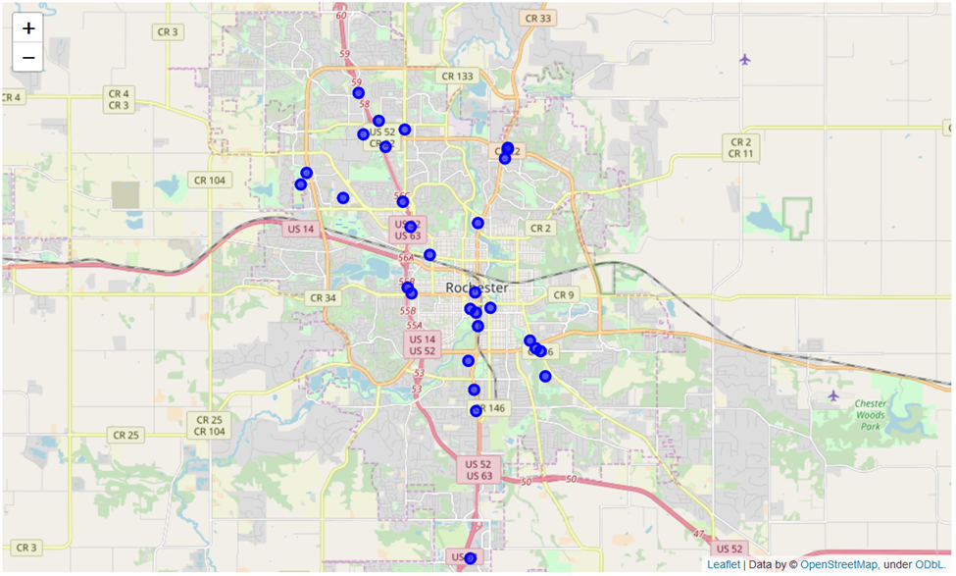
Analysis
Thirty pizza places in Rochester, MN
Sixteen pizza places left after removing restaurants with no available ratings
All thirty pizza places represented as blue dots on the map

Slide 5
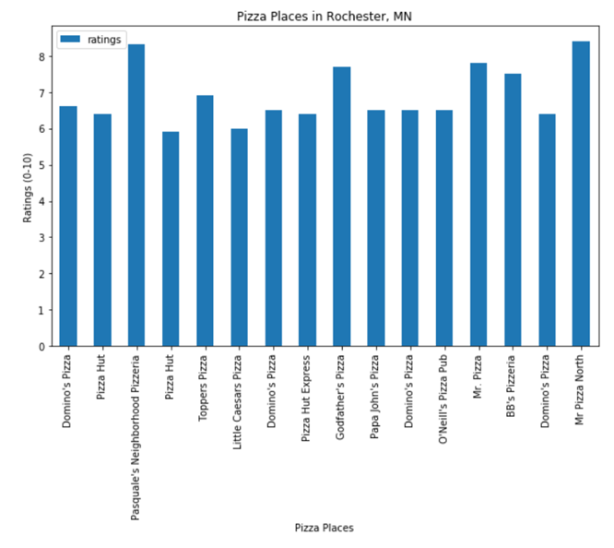
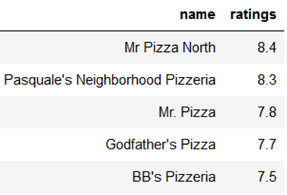
Analysis cont.
Mr. Pizza North has the highest user rating at 8.4
Pasquale’s Neighborhood Pizzeria is a close second with a 8.3 user rating
Number of likes used as a tiebreaker since ratings are so close
Mr. Pizza North – 40 likes
Pasquale’s Neighborhood Pizzeria – 18 likes

Slide 6
Conclusion
Mr. Pizza North has the best pizza in town according to my methodology
Methodology was very simple and has obvious areas for improvement
Would like to include number of dislikes
User tips would provide deeper insight into pizza quality
Ratings and likes take factors other than pizza into account such as customer service and facility
Pizza chains show up multiple times but serve the same pizza

